Slide 1
Workshop Strings
DEE 1319
Department of Electronics Engineering
National Chiao Tung University

Slide 2
Introduction
Two string types:
Legacy C-string
represented as an array of characters
end of string marked with a null character, ‘\0’
old string style inherited from C
String class
newly provided in C++
part of the C++ standard library
uses templates (Chapter 16, 19)

Slide 3
C-String Storage
A C-style string:
char s[10];
if s contains a string “Hi Mom!”, it is stored as:
‘\0’ is implicitly appended at the end
the value of ‘\0’is actually 0

Slide 4
C-String Initialization
C-string initialization
char msg[20] = “Hi there.”; // needn’t fill up the entire array
char msg[10] = “Hello world!” // error! string literal is too long
Array size can be omitted
char short String[] = “abc”; // initialized by a string literal
automatically makes size one more than length of string literal
in this case, equivalent to short String[4]
NOT same as: char short String[] = {‘a’, ‘b’, ‘c’};
in this case, equivalent to short String[3]

Slide 5
Header File and Library
Declaring C-strings
require no C++ library
no need to include any header files
built into standard C++ (just like int, double, …)
Extra manipulation functions
need to include the header file <cstring>
typically included when using C-strings

Slide 6
C-String Assignment (1/2)
C-strings are not like other built-in types
Assignment
int val=10; // ok, val is initialized with 10
val=20; // ok, val is assigned with 20
char str[10] =“Hello”; // str is initialized with a string literal
char str2[10] = “world!”
str =“world!”; // error!! str is a constant pointer
str = str2; // error!! str is a constant pointer
int ia[10], ib[10];
ia= 100; // error!! ia is a constant pointer
ia= ib; // error!! ia is a constant pointer
The reason is → the type of str:
array of characters, or
a constant pointer pointing to character
that is, str cannot be on the left side of assignment operator

Slide 7
C-String Assignment (2/2)
Q: How to do C-string assignment?
A: Use a library function: char* strcpy(char* dest, const char* src);
a built-in library function declared in <cstring>
string copy from src to dest char-by-char until ‘\0’ is reached
NO checks for string size! programmer’s responsibility!
Example
char str1[10] = “Hello”;
char str2[20] = “world!”;
strcpy(str1, “C++”); // ok now!
strcpy(str1, “Adar’s handsome”); // no compilation error,
// but big runtime problem!
strcpy(str1, str2); // ok!

Slide 8
C-String Comparison (1/2)
C-strings are not like other built-in types
Comparison
char str1[10] = “Hello”; char str2[10] = “Hello”;
bool eq1 = (str1 == str2); // eq1 ← false!!!
int a1[2] = {1, 2}; int a2[2] = {1, 2};
Bool eq2 = (a1 == a2); // eq2 ← false
The reason is → the type of str:
array of characters, or
a constant pointer pointing to character
that is, the value of str represents a specific address

Slide 9
C-String Comparison (2/2)
Q: How to do C-string comparison?
A: Use a library function: int strcmp(const char* str1, const char* src);
a built-in library function declared in <cstring>
compare str1 against str2 using lexicographic order
return value:
negative → str1 < str2
0 → str1 == str2 (str1 and str2 are identical)
positive → str1 > str2
Example
char str1[10] = “Hello”;
char str2[20] = “world!”
if ( strcmp(str1, str2) == 0 )
cout<< “Same!\n” << endl;

Slide 10
Other Functions
strlen()
Get string length size_t strlen(const char*);
char myString[10] = “dobedo”;
cout << strlen(myString);
strcat()
Concatenate two strings char* strcat(char* dest, const char*src);
char str1[30] = “Hello ”;
char str2[20] = “wonderful world!\n”;
strcat(str1, str2);
cout<< str1; // “Hello wonderful world!”
strcat(str1, str2); // a big runtime problem here

Slide 11
C-String Line Input (1/2)
What if we want to input a string having whitespaces?
Use cin.getline()
getline(char* s, stream_size n) is a member function of class istream
it can receive an entire input line into C-string
char a[80];
cout<< “Enter input:” ;
cin.getline(a, 80);
cout<< a << “END OF OUTPUT\n”;
dialogue:
Enter input: Do be do to you!
Do be do to you!END OF OUTPUT

Slide 12
C-String Line Input (2/2)
Can explicitly tell the maximum length to receive:
char shortString[5];
cout<< “Enter input: ”;
cin.getline (shortString, 5);
cout<< shortString<< “END OF OUTPUT\n”;
results:
Enter input: dobedowap
dobeEND OF OUTPUT
forces FOUR characters only be read
the last one for a null character!

Slide 13
Functions in <cctype> (1/2)
Upper-lower case conversions
Int toupper(int);
Int tolower(int);
Examples: char ch1, ch2;
ch1 = ‘a’;
ch2 = toupper(ch1); // ch2 = ‘A’
ch2 = toupper(‘B’); // ch2 = ‘B’
ch2 = toupper(‘5’); // ch2 = ‘5’
ch2 = tolower(‘A’); // ch2 = ‘a’
ch2 = tolower(‘b’); // ch2 = ‘b’
ch2 = tolower(‘5’); // ch2 = ‘5’

Slide 14
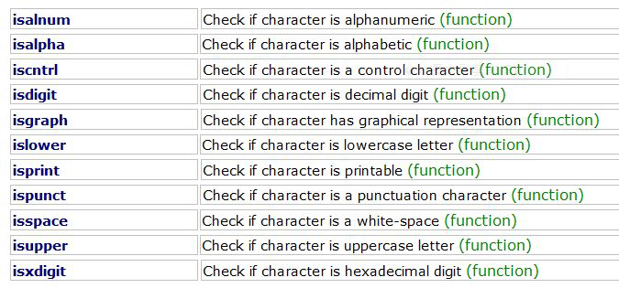
Functions in <cctype> (2/2)
intisXXXXX(intc);
Return nonzero if true ; zero if false

Slide 15
Class string
Defined in the standard C++ library
#include <string>
using namespace std;
Can perform assignment, comparison, addition, …
Example:
string s1, s2, s3;
s3 = s1 +s2; // concatenation
s3 =“Hello Mom!” // assignment
note C-string “Hello Mom!” can be assigned to a string using string& operator=(const char*);

Slide 16
Constructors and Assignment
Ctors
string(); // default, an empty string
string(const string&); // copy ctor
string(const char* s); // a string initialized by s
and more …
Assignment operators (member functions)
string& operator=(const string&);
string& operator=(const char*);
string& operator+=(const string&);
string& operator+=(const char*);
and more …

Slide 17
Capacity and Element Access
Capacity (member functions)
size_t size() const; // get string length
size_t length() const; // get string length; same as size()
bool empty() const; // Is it an empty string?
and more …
Element access (member functions)
char& operator[](size_t p); // return the reference of p^{th} character in string, no range checking
char& at(size_t p); // return the reference of p^{th} character in string, with range checking
and more …
string str(“hello”);
str[0] = ‘H’; // str contains “Hello” now
Int i= str.size(); // i= 5

Slide 18
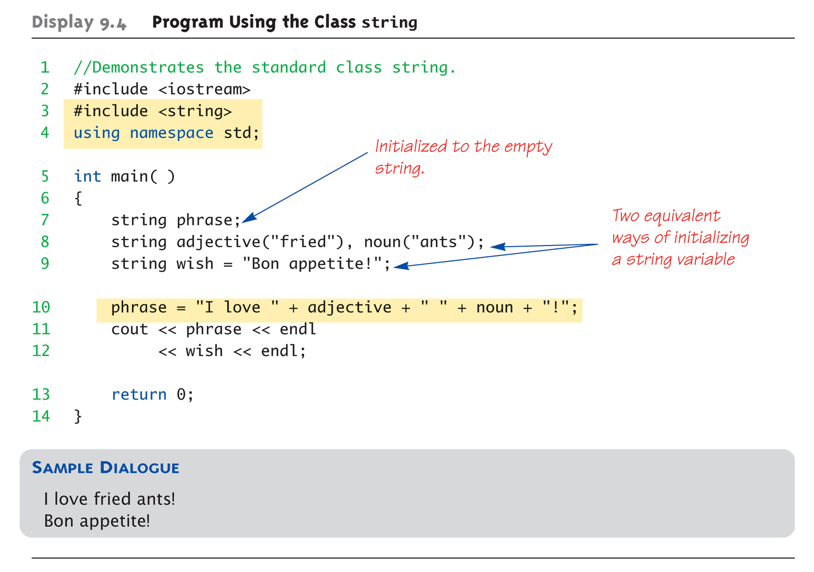
Uses of string

Slide 19
string I/O with >> and <<
Operators >> and << are overloaded for string type
istream& operator>>(istream&, string&);
ostream& operator<<(ostream&, const string&);
string s1, s2, s3(“Hello world!”);
cin>> s1 >> s2;
cout<< s3;
Results
User types in: Long live the king!
Extraction still ignores whitespaces
s1 receives value “Long”
s2 receives value “live”

Slide 20
string I/O with getline() (1/2)
To get a complete input line
global function: istream& getline(istream&, string&);
string line;
cout<< “Enter a line of input: ”;
cin.clear();
getline(cin, line);
cout<< line << “END OF OUTPUT”;
Dialogue produced
Enter a line of input: Do be do to you!
Do be do to you !END OF INPUT
Similar to C-string’s usage of getline()

Slide 21
string I/O with getline() (2/2)
You can specify your own delimiter character
istream& getline(istream&, string&, char delim);
string line;
cout<< “Enter input: ”;
cin.clear();
getline(cin, line, ‘?’);
receives input until ‘?’ is encountered
getline() returns reference
string s1, s2;
getline(cin, s1) >> s2; // ok to do this

Slide 22
Substring and Find Operations (1/2)
Substring (member functions)
string substr(size_tpos = 0, size_tn = npos) const;
Find (member functions)
size_t find(const string& str, size_tpos = 0) const; // first one
size_t find(const char* s, size_tpos = 0) const;
size_t rfind(const string& str, size_tpos = npos) const; // last one
size_t rfind(const char* s, size_tpos = npos) const;
size_t find_first_of(const string& str, size_tpos = 0) const;
size_t find_last_of(const string& str, size_tpos = npos) const;
size_t find_first_not_of(const string& str, size_tpos = 0) const;
size_t find_last_not_of(const string& str, size_tpos = npos) const;
and more …

Slide 23
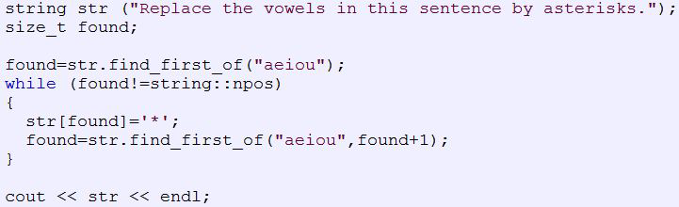
Substring and Find Operations (2/2)

Slide 24
Exercise (1/2)
Input a string
Input a number, if we input -1, the program ends. If we input 0, it replaces substrings in left table with substrings in right table. If we input 1, it replaces substrings in right table with substrings in left table.
A | B
(happy) | :D
(heart) | <3
(confused) | o.O
(good) | (y)
(angel) | O:)

Slide 25
Exercise (2/2)
Useful link:
http://www.cplusplus.com/reference/string/string/find/
http://tw.tonytuan.org/2007/10/cin-getlinecin-s.html
http://yeouching.com/?p=2149

